Slide 1
The Business Case for Investing
in Florida’s Children
Mark Wilson | President & CEO | mwilson@flchamber.com
Download this presentation here:
www.FLChamber.com/ChildrensForum

Slide 2
The Florida 2030 Blueprint: Uniting Businesses For Good
17th to 10th
39 Goals
+4 Million
+2 Million
+50 Million
+3 Million
www.Florida2030.org

Slide 3
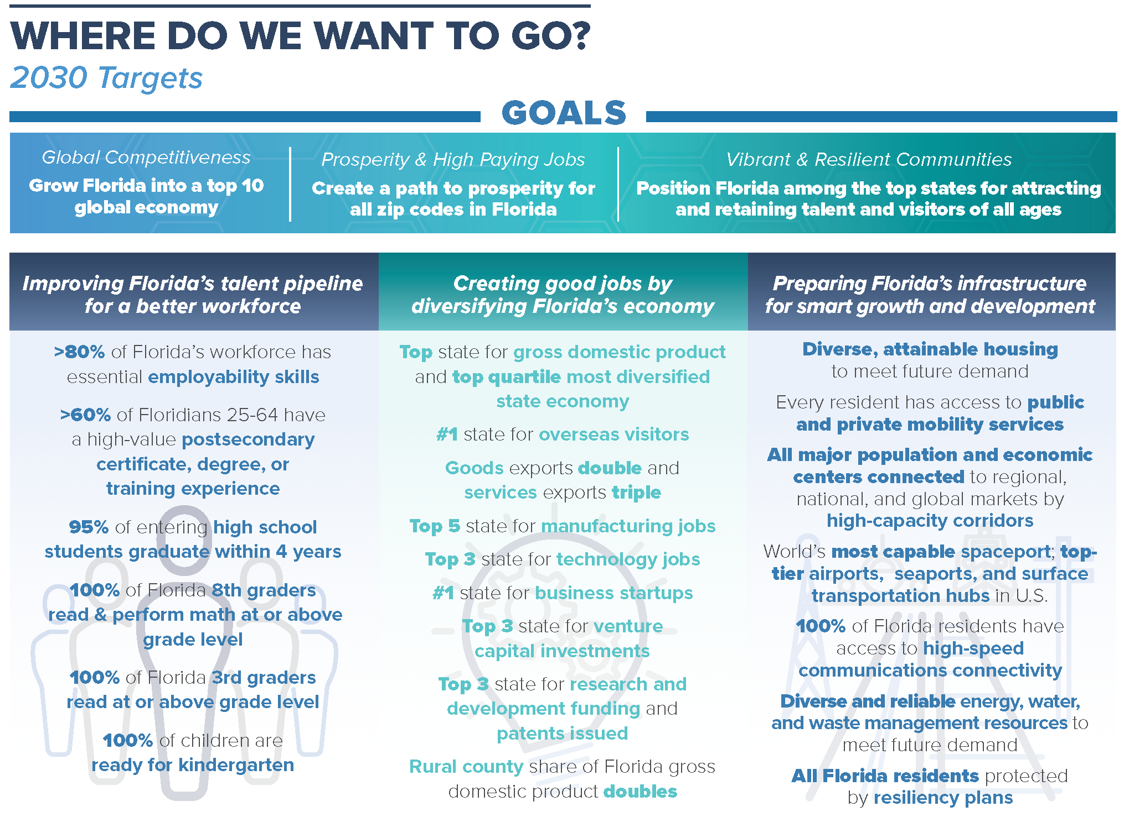
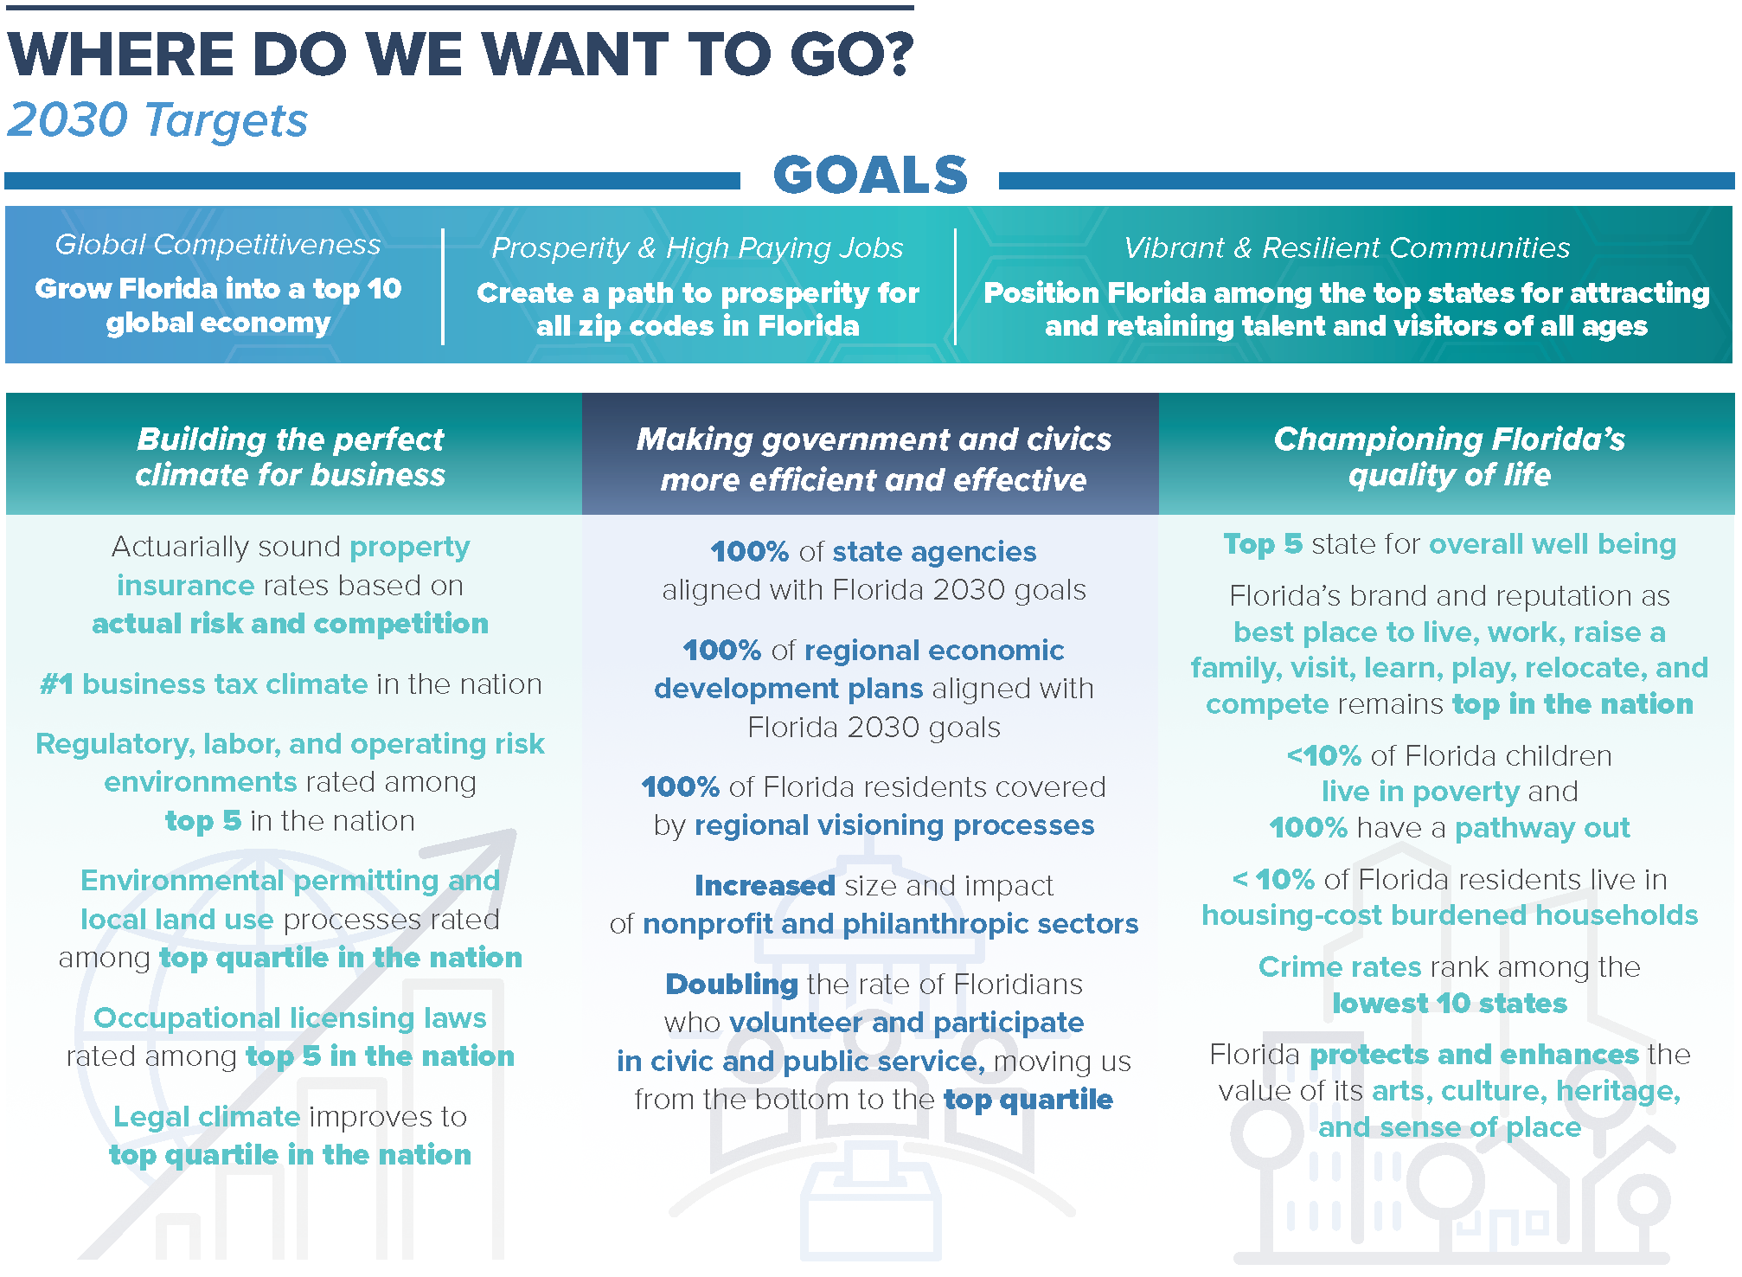
39 Goals to Create Economic Opportunity in Every Zip Code

Slide 4
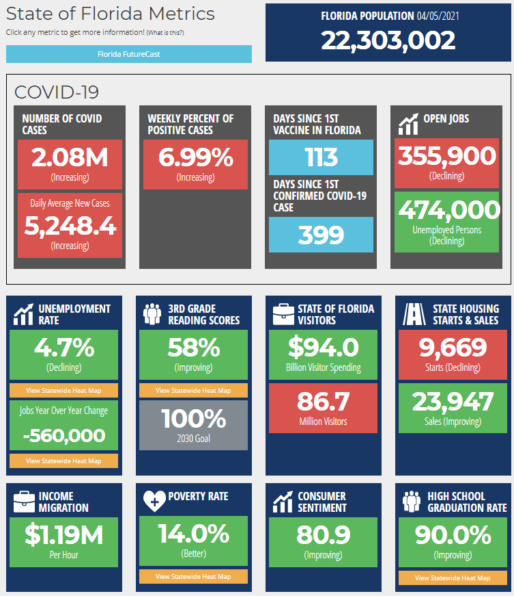
Florida At-A-Glance
Florida’s Economy $1.1 Trillion GDP (17th)
22 Million Residents
3rd / 26M By 2030
Pre-COVID
More Than 900/Day
131.4 Million Visitors In 2019 (+50M by 2030)
Florida Created More Than 1 Out of Every 11 New U.S. Jobs since 2015
www.TheFloridaScorecard.org

Slide 5
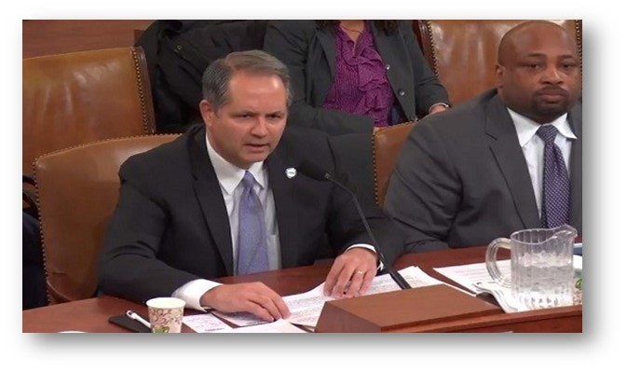
Florida Chamber Congressional Testimony- March 1, 2016
“In my view, the battle of this generation is between economic equality and economic opportunity – between those who believe that everyone is entitled to equal outcomes and those who believe everyone should have an equal opportunity at earned success.”
- Mark Wilson, President and CEO

Slide 6
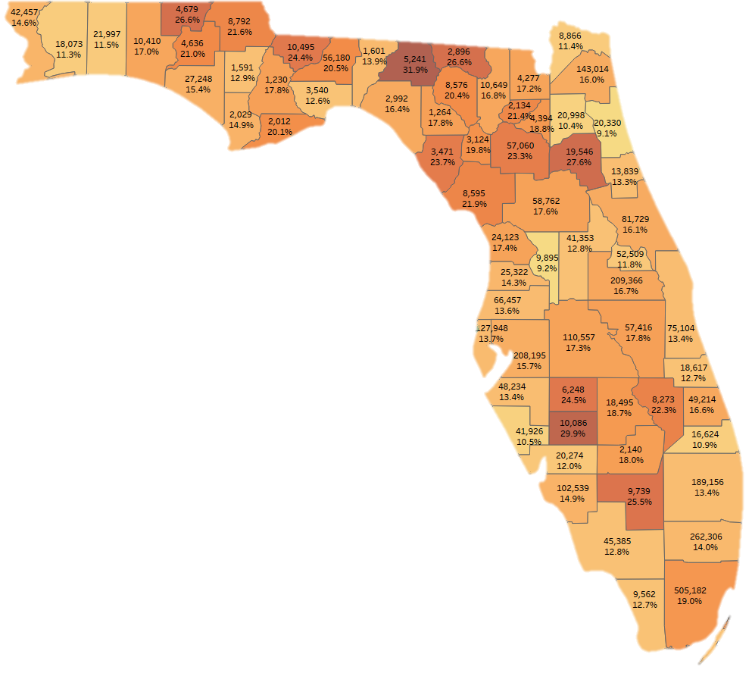
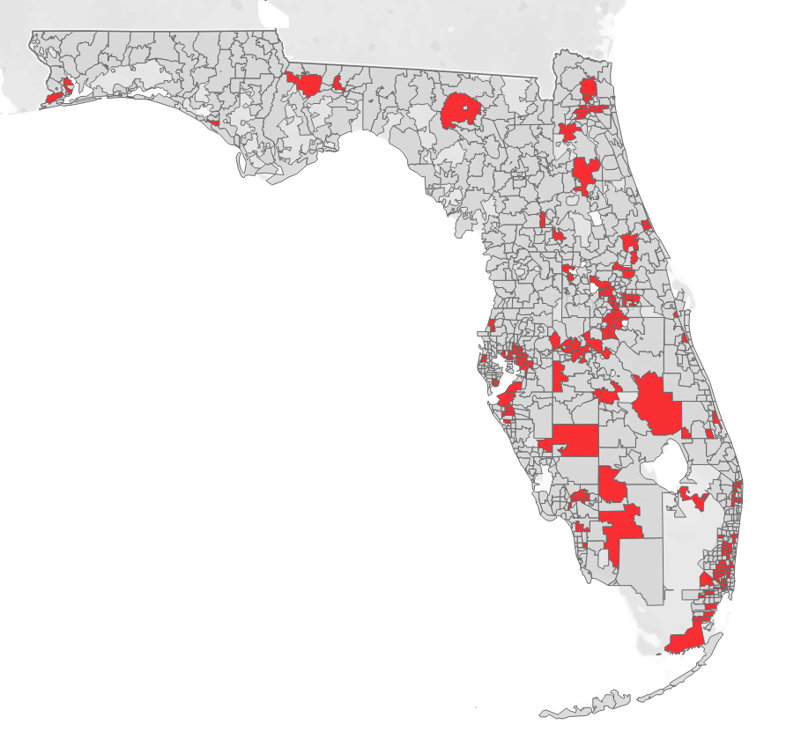
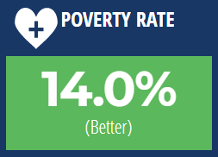
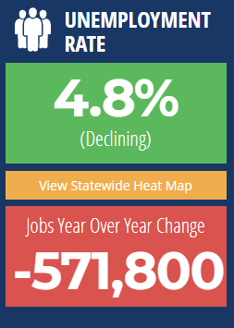
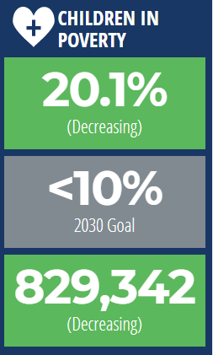
State-Of-The-Art Mapping To Identify The Gaps In Each Community
415,296 kids live in poverty in these 150 zip codes.
That’s 50.1% of Florida’s kids living in poverty
Top Number: People living in Poverty
Bottom Number: Poverty Rate
Source: The Florida Prosperity Project, Florida Chamber Foundation

Slide 7
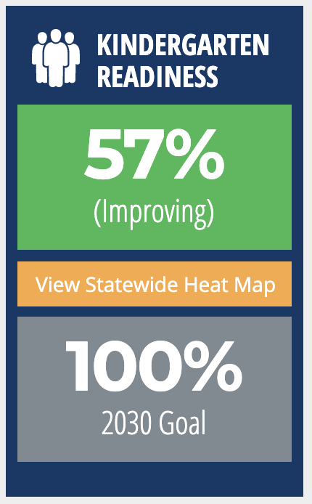
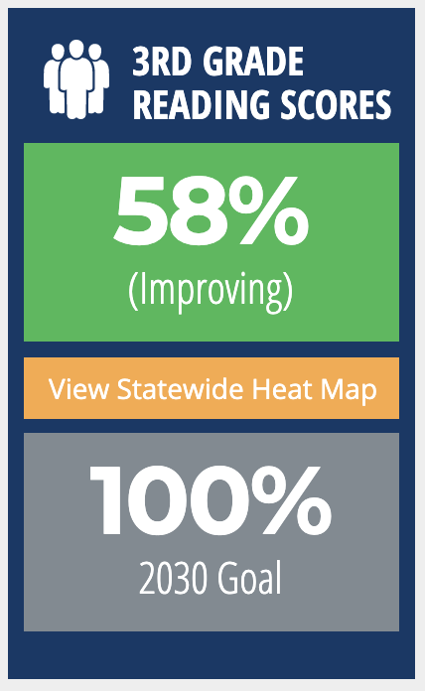
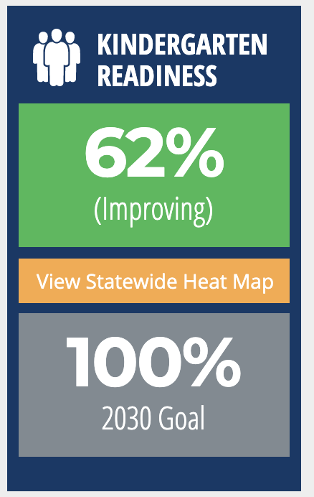
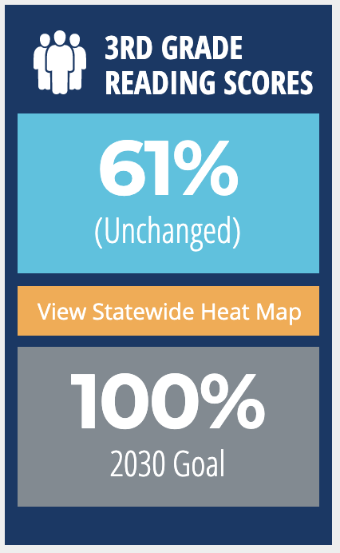
TheFloridaScorecard.org
Statewide Numbers
Leon County Numbers
Kindergarten Readiness
Goal Leader:
3rd Grade Reading
Proficiency Goal Leader:

Slide 8
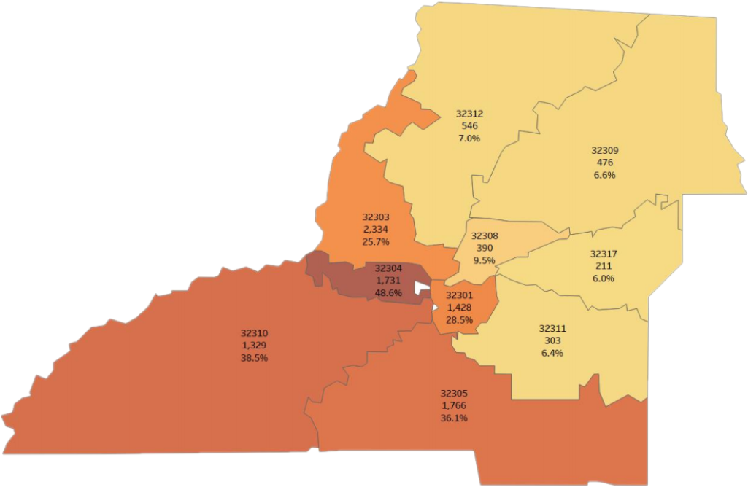
Zip Codes Matter
The Difference of Just Two Miles
32304
Number of Children in Poverty: 1,731
Percentage of Children in Poverty: 48.6%
Average Third Grade Reading Score: 22
32308
Number of Children in Poverty: 390
Percentage of Children in Poverty: 9.5%
Average Third Grade Reading Score: 72

Slide 9
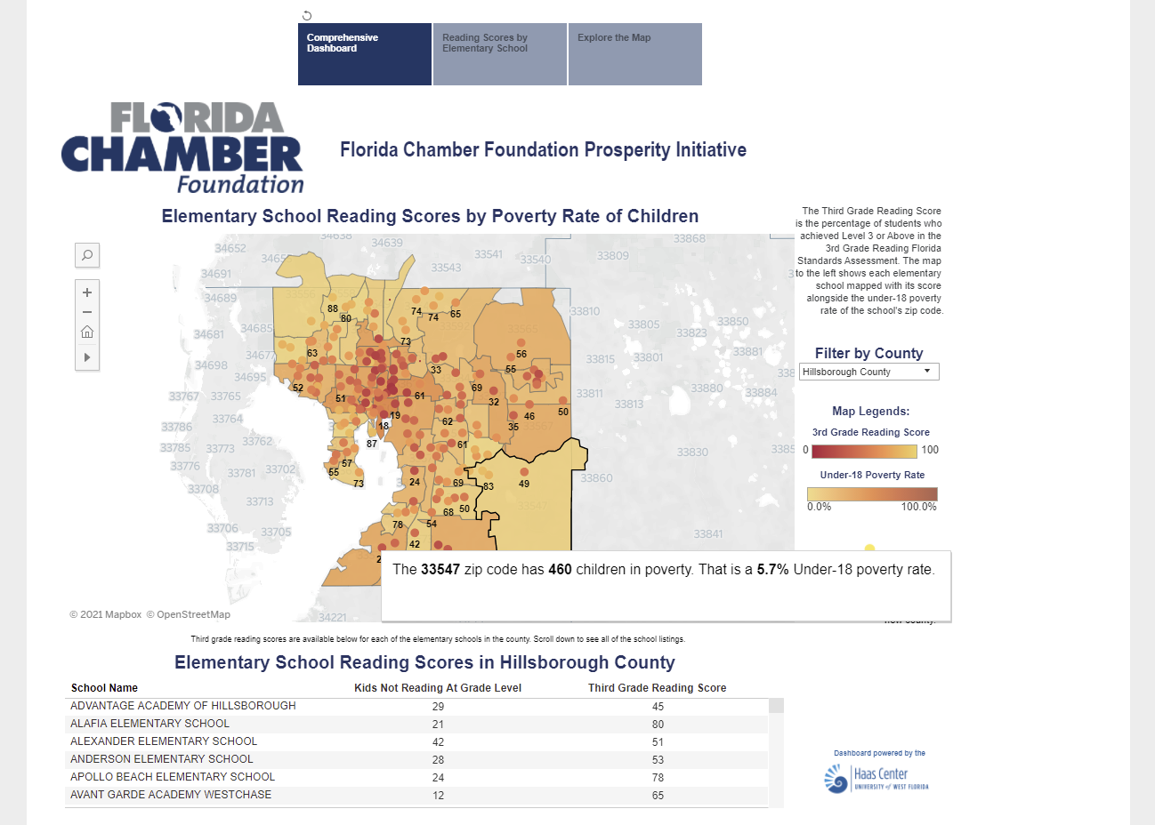
www.TheFloridaGapMap.org

Slide 10
91,065 Florida 3rd Graders Not Reading at Grade-Level
1,008 of Those 3rd Graders are in Leon County
Visit www.TheFloridaGapMap.org to learn how many third graders aren’t reading on grade-level in your community.

Slide 11
The Florida Equality of Opportunity Initiative
America’s first comprehensive, Chamber-led strategy to cut childhood poverty in half, ensure all third graders are reading at grade level, and champion diversity and inclusiveness in the workplace
To learn more visit www.FLChamber.com/EqualityFL
Notes:
Addressing Early Learning to Spark Prosperity and Ensure Diversity, Equity, and Inclusion

Slide 12
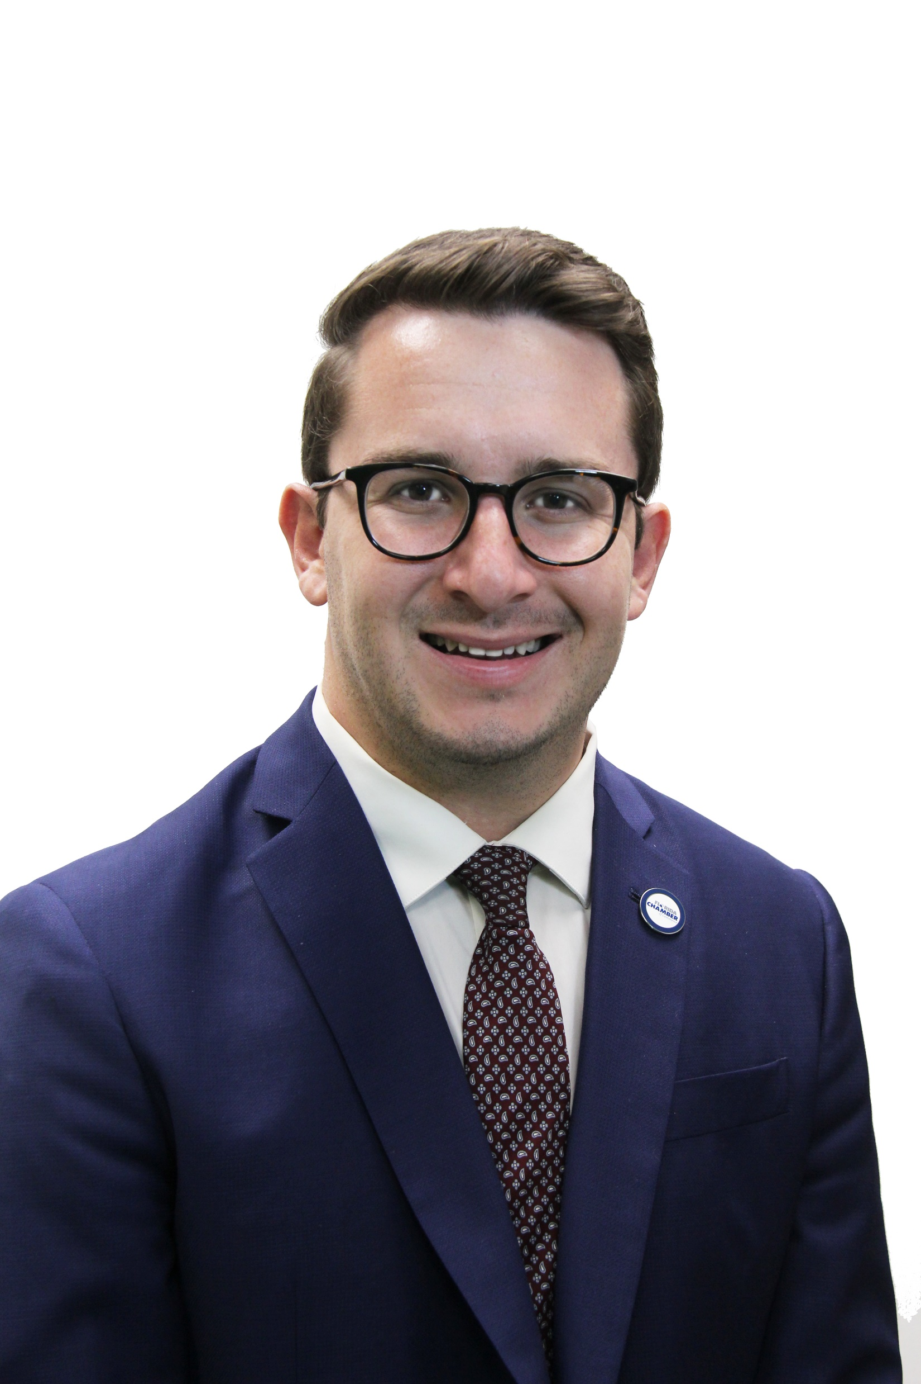
Florida Chamber Launches Florida Equality of Opportunity Initiative
Join The Movement
Kyle Baltuch – Sr. VP of Equality of Opportunity
kbaltuch@FLfoundation.org
850-521-1218
“Groundbreaking”
“This Florida Chamber Foundation initiative is aimed at unifying business leaders to ensure every Floridian is given an equal opportunity to secure their future.”

Slide 13
Register Today for Our Upcoming Summits
2021 Florida Prosperity & Economic Opportunity Solution Summit
2021 Florida Learners to Earners
Workforce Solution Summit
To register visit www.flchamber.com/events

Slide 14
Download this presentation here:
www.FLChamber.com/ChildrensForum
Mark Wilson | President and CEO | mwilson@flchamber.com

